Slide 1
SB 21-181
Health Equity Report
Presented by: Sheila Davis, MD, MS
Director, Office of Health Equity
Colorado Department of Public Health and Environment
Notes:
Good Afternoon.
Thanks for the invitation. I am Dr. Sheila Davis, Director of the Office of Health Equity for the Colorado Department of Public Health and the Environment. I will share the priorities of the Office with you this afternoon.

Slide 2
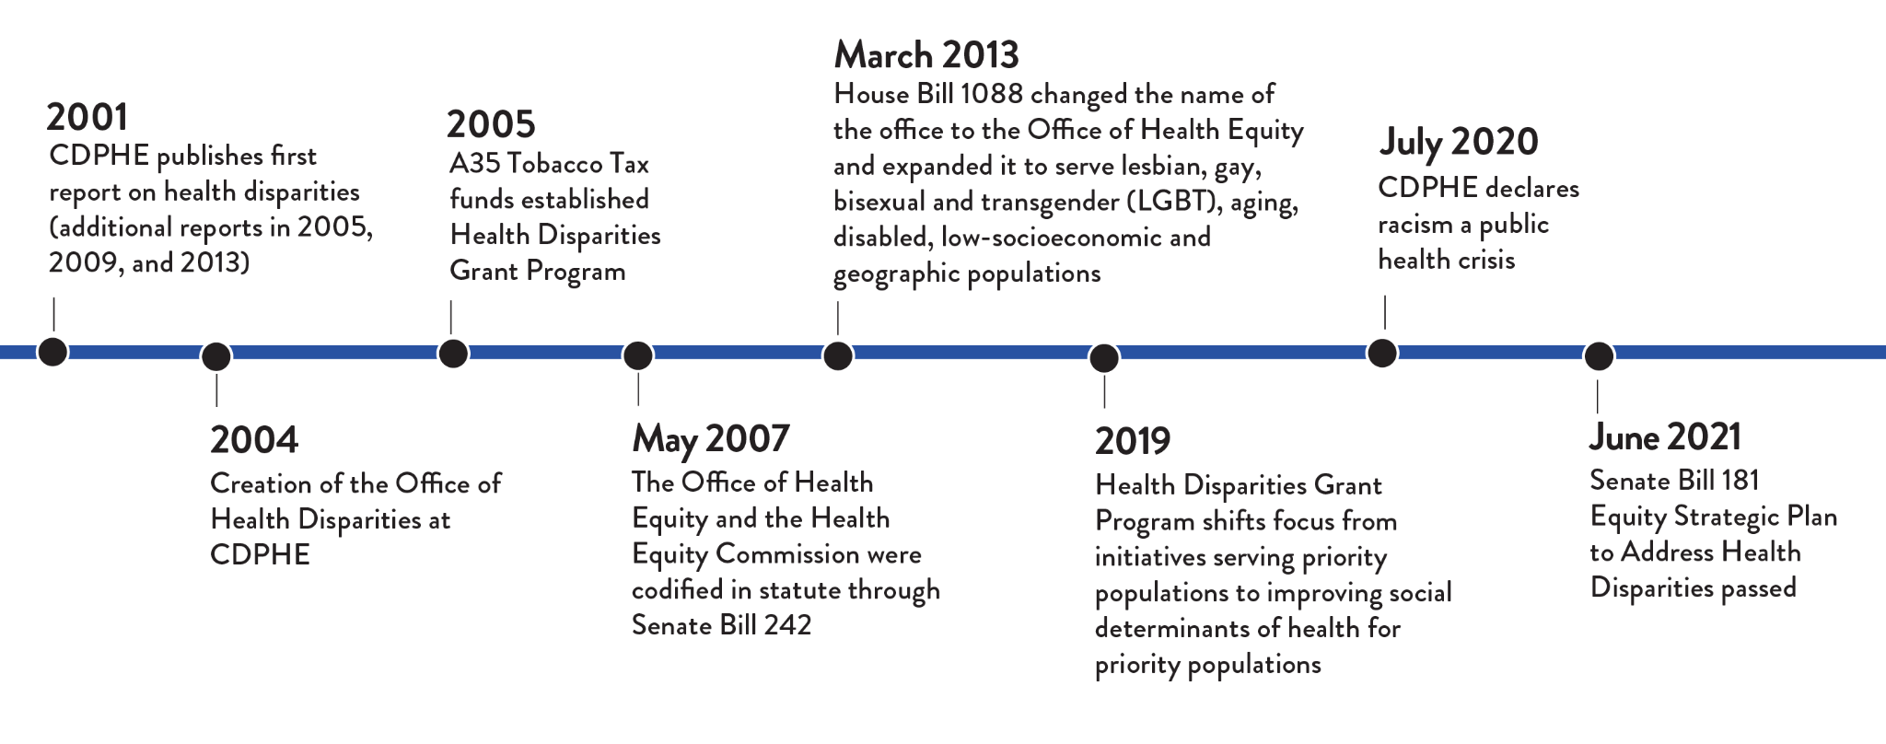
CDPHE’s dedication to equity
Notes:
I would like to begin with a history of the Office.

Slide 3
Racism is a public health crisis
CDPHE declared racism a public health crisis in July 2020.
These declarations are an important first step in the movement to advance racial equity and justice and must be followed by allocation of resources and strategic action.
Public health's responsibility to address racism includes reshaping statewide discourse and agendas so that we all actively engage in racial justice work.
CDPHE acknowledges that social, economic, and environmental inequities result in negative health outcomes and have a greater impact than individual choices.
By changing policies and practices we can reduce disparities and help improve opportunities for all Coloradans.
Notes:
In the last 5 years, public health has come a long way in naming racism, rather than “race”, as a risk factor and declaring racism as a crisis. CDPHE declared racism a public health crisis in July 2020, and as of August 2021, these declarations have been made in 37 states. They are an important step in advancing equity and racial justice but must also be followed by action. This presentation and our health equity reports are a step toward reshaping statewide discourse and moving the conversation and agenda upstream to social, economic, and environmental forces shaping health as we know they have a greater impact than individual choices. This declaration was an acknowledgment that by changing the policies and practices that drive these forces, we can advance equity, reduce disparities, and help improve opportunities for all Coloradans.

Slide 4
SB21-181 - Equity Strategic Plan to Address Health Disparities
Health Disparities and Community Grant Program (HDCGP)
Health equity report(s) and strategic planning process
Health Equity Commission representation (HEC)
Provides additional funds for community grants to positively affect social determinants of health and close disparities.
Requires reports of inequities faced by BIPOC (published by 7/2022), aging, people with disabilities, LGBTQ+, economically disadvantaged, and rural populations.
Reports will inform an equity strategic planning process that must begin by 7/2022.
Adds additional Executive Directors of state agencies to the HEC.
Requires all agencies represented on the HEC to develop a plan to address inequities in social determinants of health relevant to their agency.

Slide 5
State agencies represented on HEC
Department of Corrections | Department of Education | Department of Higher Education | Department of Human Services | Department of Health Care Policy and Financing
Department of Labor and Employment | Department of Local Affairs | Department of Public Health and Environment | Department of Public Safety | Department of Transportation

Slide 6
Conceptual framework for the reports
Source: “A Public Health Framework For Reducing Health Inequities”, Bay Area Regional Inequities Initiative, 2020.
Notes:
Let’s pivot and look at the health inequities reports. This is the framework that we are using to write the report. It is called the Bay Area Regional Health Inequities Initiative Framework. What is significant about this framework is that it puts risk behaviors in the context of the environment in which people live, work, pray, and play.

Slide 7
Structure of the report
Introduction
Executive summary
What’s at stake
Acknowledging strengths, resilience, and progress
Persistent patterns of disparities across life course and many outcomes
Public health focus and investments downstream
Historic missteps of public health in addressing inequity
Notes:
We are defining what’s at stake. I don’t know if you have read health inequities reports. They tend to put blame communities of color for poor health outcomes. We are adopting a different approach.

Slide 8
Structure of the report
Report framework and guiding principles and questions
Bay Area Regional Health Inequities Initiative Framework
Race, racism, weathering, and inherited trauma
Limitations of quantitative data
Unique histories of communities of color within Colorado
Biased policies and practices and how they affect upstream determinants of health
How upstream determinants connect to risk and protective behaviors and health outcomes

Slide 9
Structure of the report
The landscape of the upstream determinants of health in Colorado
Intersectionality
Tying health outcomes back to the upstream determinants of health
A call to action
Promising policies and programs
Recommendations
Next steps: strategic planning

Slide 10
Health outcomes highlighted in the report
Life expectancy
Chronic diseases | Injury and Violence
Cancers (colorectal, prostate, breast) Heart disease Cerebrovascular disease Diabetes Liver disease/cirrhosis | Motor vehicle accidents Drug overdose Suicide Homicide Legal intervention
Maternal and child health | Communicable disease
Maternal mortality Infant mortality | COVID-19

Slide 11
Upstream determinants: physical environment
Physical environment | Residential segregation
 | Food access (rate of healthy food/fast food outlets per 10,000 pop)
 | Alcohol access
 | Park access
 | Traffic proximity
 | Transportation
 | Access to safe places to walk
 | Air contamination (PM2.5, diesel PM, average air toxic emissions)
 | Lead risk
Source: Tree by Brian Hurshman from NounProject.com.

Slide 12
Upstream determinants: economic environment
Economic & work environment | Median household income
 | Poverty and childhood poverty
 | Percent of households receiving SNAP/food stamps
 | Unemployment
 | Homeownership
 | Housing cost burden
 | Nutrition security
 | Housing security
 | Homelessness
 | Foregoing health care due to cost
Source: Economy by LAFS from NounProject.com.

Slide 13
Upstream determinants: service environment
Service environment | Educational attainment
 | Four-year high school graduation rates
 | Computer and broadband access
 | Health insurance (adults, children eligible but not enrolled in Medicaid/CHP+)
 | Having one or more regular health care providers
 | Quality health care (respect and perceived equality of services)
 | Adequate prenatal care
 | Receiving behavioral health care when needed
 | Access to affordable, quality child care
Source: Service by Phonlaphat Thongsriphong from NounProject.com.

Slide 14
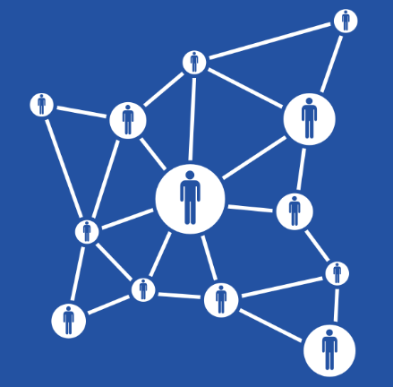
Upstream determinants: social environment
Social environment | Linguistic isolation of households
 | Single-adult headed households
 | Civic engagement (voter participation)
 | Adverse childhood experiences
 | Disconnected youth
 | Incarceration
 | Violent crime victimization
Source: Network by Gilbert Bages from NounProject.com.

Slide 15
Inequities in our data systems
Inequitable representation
Inequitable content
Community voice not included in system development
Random sampling
Misclassification
Focused on downstream not upstream
Improper aggregation
Focused on deficits not strengths
Suppression
Cannot easily balance quantitative with qualitative data
Source: Sampling by Caputo, Wrong by Llisole, Taxonomy by Cécile Lanza Parker, Muted Microphone by Flamingo, Democracy by Fahmi, River by Turkkub, Negative by Andrejs Kirma, Story by from NounProject.com.

Slide 16
The importance of story
Shows value and respect for different ways of knowing
Until we can create more equitable data systems, addresses some of their key limitations and blind spots
Represent unique and nuanced experiences
Self-identification and intersectionality
Highlight strengths rather than deficits
Can span the whole stream of health determinants within a single sentence
Can quickly and poignantly show complex connections between experiences, decisions, and health

Slide 17
Questions?
Sheila Davis, MD MS
Director, Office of Health Equity
Colorado Department of Public Health and Environment
720-245-4198
sheila.davis@state.co.us
Contact
Sarah Blackwell, MPH
Health Equity Data Manager
Colorado Department of Public Health and Environment
609-731-5360
sarah.blackwell@state.co.us

